Slide 1
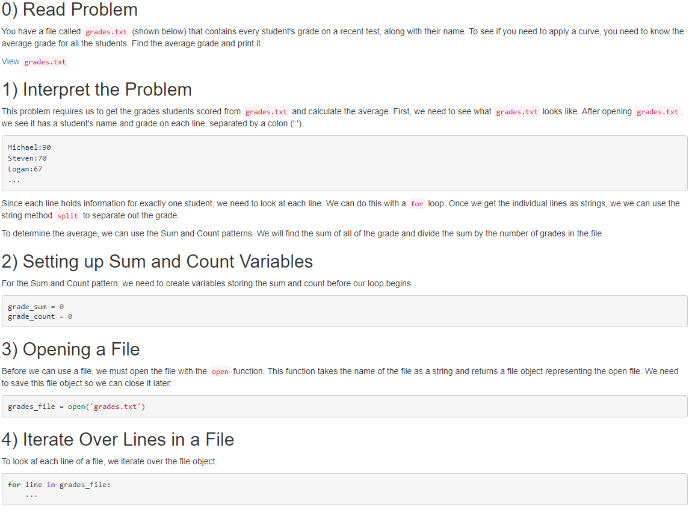
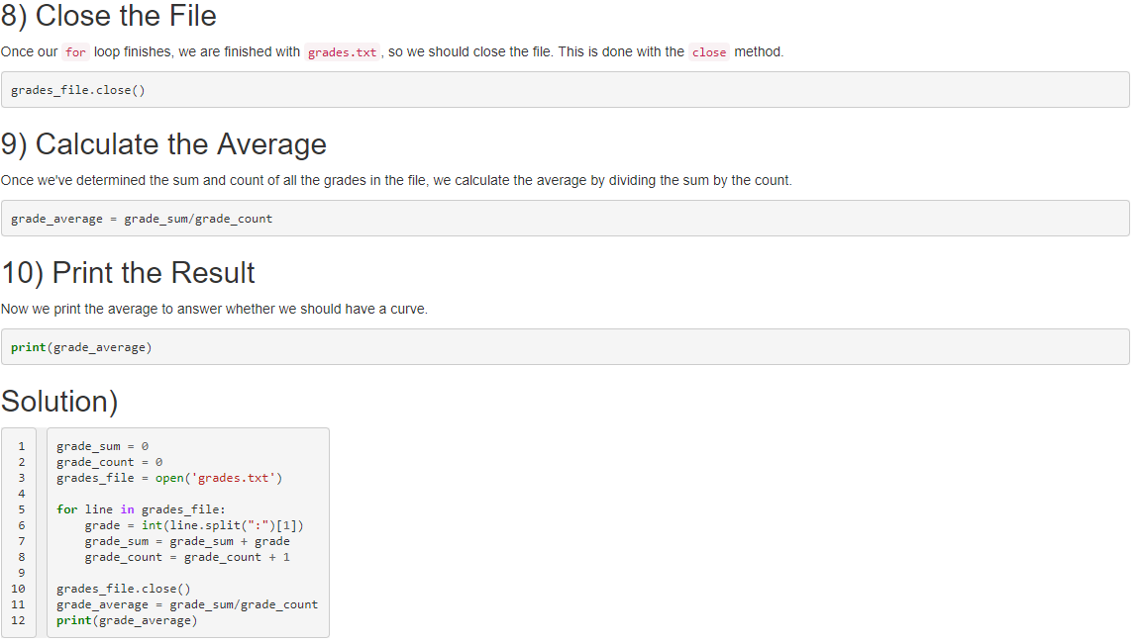
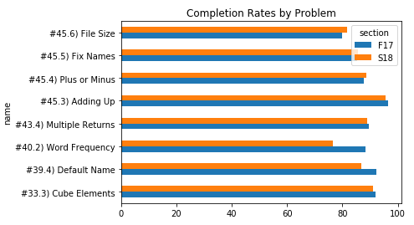
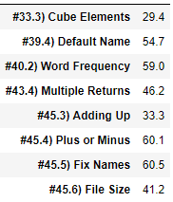
Supplementing Introductory Experiences With Worked Examples
Michael Friend under direction from Austin Cory Bart
VT Logo
Problem
Interest in computing is growing, leading to huge introductory computing class sizes [NAS].
Further, many assignments in these courses can be challenging for students, even when they only exercise a few concepts [RAINFAILL].
Worked Examples have shown promise as a scaffold to help students complete programming assignments. However, there have been limited classroom studies to evaluate the effectiveness of Worked Examples.
Hypothesis
Adding worked examples related to difficult problems will improve understanding of the problems and their ability to program
Research Questions
Do WEs improve performance?
Do students take advantage of worked examples?
Do students find WEs helpful?
Prior Work
Prior work suggests providing WEs with clear subgoal labels help students deconstruct problems. [Morrison]
Educational Theories
Worked Examples[Renkl][Sweller]
Example-Problem Pairs[Skudder]
Subgoal Learning [Morrison]
Context
Introduction to Programming in Python
Non-CS majors from mostly Engineering and Sciences
Students complete 188 programming assignments in and online programming environment
Keystroke level edits and environmental interactions are logged
 | Prior Experience | No Prior Experience | Total
F17 | 240 | 41 | 281
S18 | 197 | 43 | 240
Total | 437 | 84
Methodology
Manual inspection of prior student was used to determine “hard” problems
“Hard” problems were those that took most students more than 20 edits to complete
Worked examples were developed for “hard” problems to help students
Sample Worked Example
Data Collection
Qualitative Data collected via a survey on student opinion and usage of Worked Examples
Quantitative Data collected via exercise completion rates and student interaction with Blockpy and Worked Example
Worked Examples page was instrumented to log student interaction
Results
64% of students found the Worked examples helpful.
 | Prior Experience | No Prior Experience | Total
WE Helpful | 108 | 29 | 137
WE Not Helpful | 66 | 12 | 78
Total | 174 | 41
Conclusions
The Worked Example strategy we used seem to have little effect on the completion rate of hard problems. However, many students used them and found them helpful.
Methods of selection “hard’ problems may have been flawed. All problems had high completion rates (80-90%) before introducing WEs.
The correlation between WE use and increased number of runs may suggest our implementation had no quantitative benefit. It may also simply show that students are more likely to use the WE if they have been working on the problem for longer. More analysis of event log is required to support this.
Future work
Interactive Worked Examples
Subgoal only Worked Examples
Alternative supplements material in large intro classes
Students who used Wes actually completed the problem in more runs/time than those that didn’t
Measured usage of WE varied widely by problem, with an average around 50
Super Nice Visual For filtered WE Use X Prior Exp vs Runs
The addition of Worked Examples provided little to no gain on completion of hard problems
References
TODO

